Slide 1

Recommendations For Planning Marketing Budget- 2017
Jasmeeta Kaur, Chief Data Analyst, GameCo

Slide 2
Recommendation 1 Region To Focus in

Slide 3
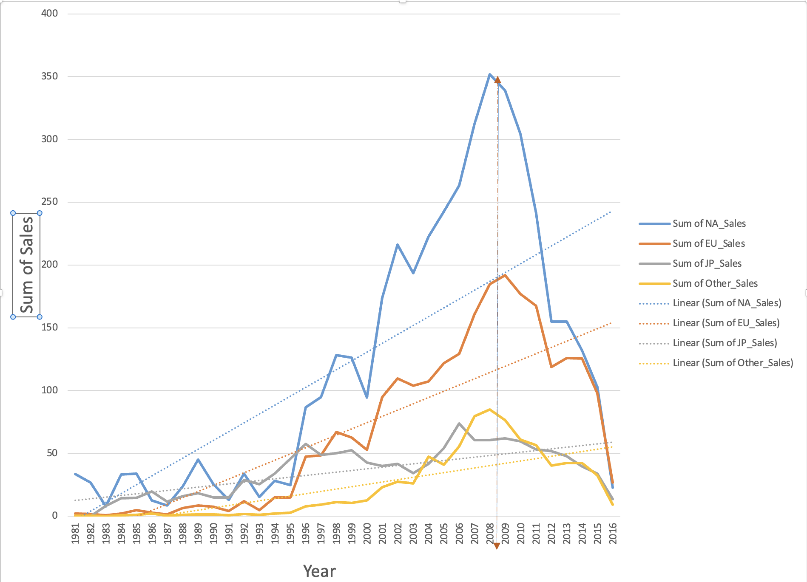
Variation Of Sales Across Different Regions

Slide 4

Interpretations & Conclusions From the Graph
Sales across regions have not stayed constant over the years as is clearly evident from the above graph.
After a steady increase till 2008 for all the regions, the sales figured have shown a sudden steep decline.
North America has always been a major contributor to the market sales (even during the decline phase).
Till 2016 the EU_Sales had almost become compatible with NA_Sales.
Positive trendline still shows that the video games market should flourish.

Slide 5
Summary - Sales Figures Variation Across Regions Over Time
Sales for various regions have not stayed the same over time
North America has been always a major contributor to the market sales but there is a decline after 2009
Positive trendline shows that the video games market should flourish

Slide 6
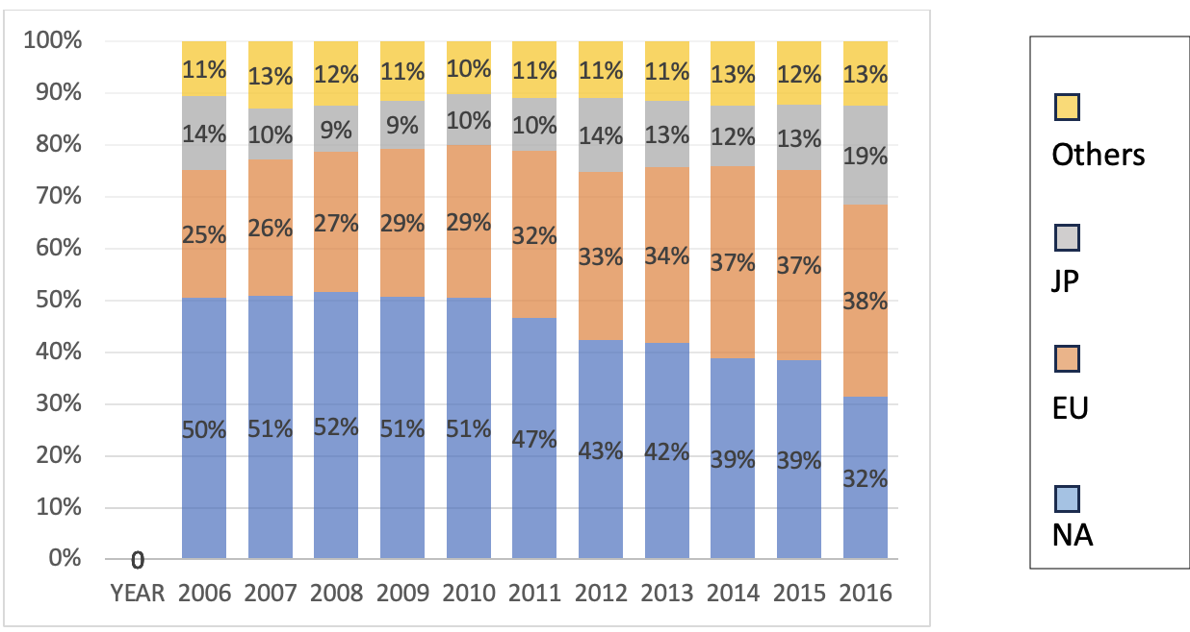
Sales Percentage across different regions(2006-16)

Slide 7
Percentage Sales Figures Variation Across Regions Over Time
NA sales proportion have decreased considerably in 2016
EU and JP regions have shown an increase in proportion of global sales since 2010
Although other regions(potentially China and India) have the least market share, they show an improved market performance

Slide 8
Recommendation 2 Top 5 Genres To Invest In(Across Regions)

Slide 10
Relative Popularity Of Games
The highest grossers in North America:
Action
Adventure
Shooter
Sports
Other potential game genres which can be focused on:
Role playing
Misc
Platform
Racing

Slide 11
Recommendation 3 Competitors To Watch Out For

Slide 12

Competitor Publishers Per Region, In North America

Slide 13
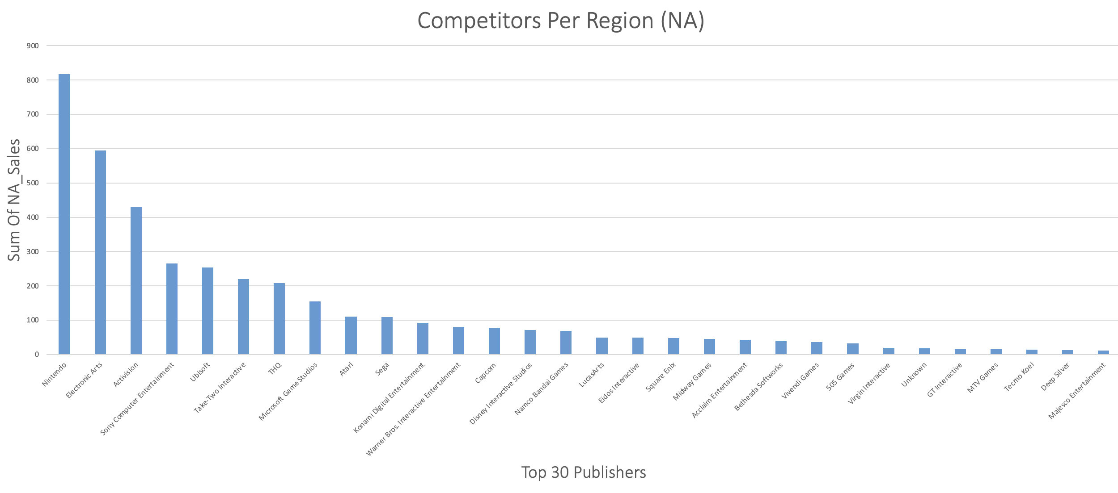

Slide 14

Competitor Publishers Per Genre (In North America)

Slide 15
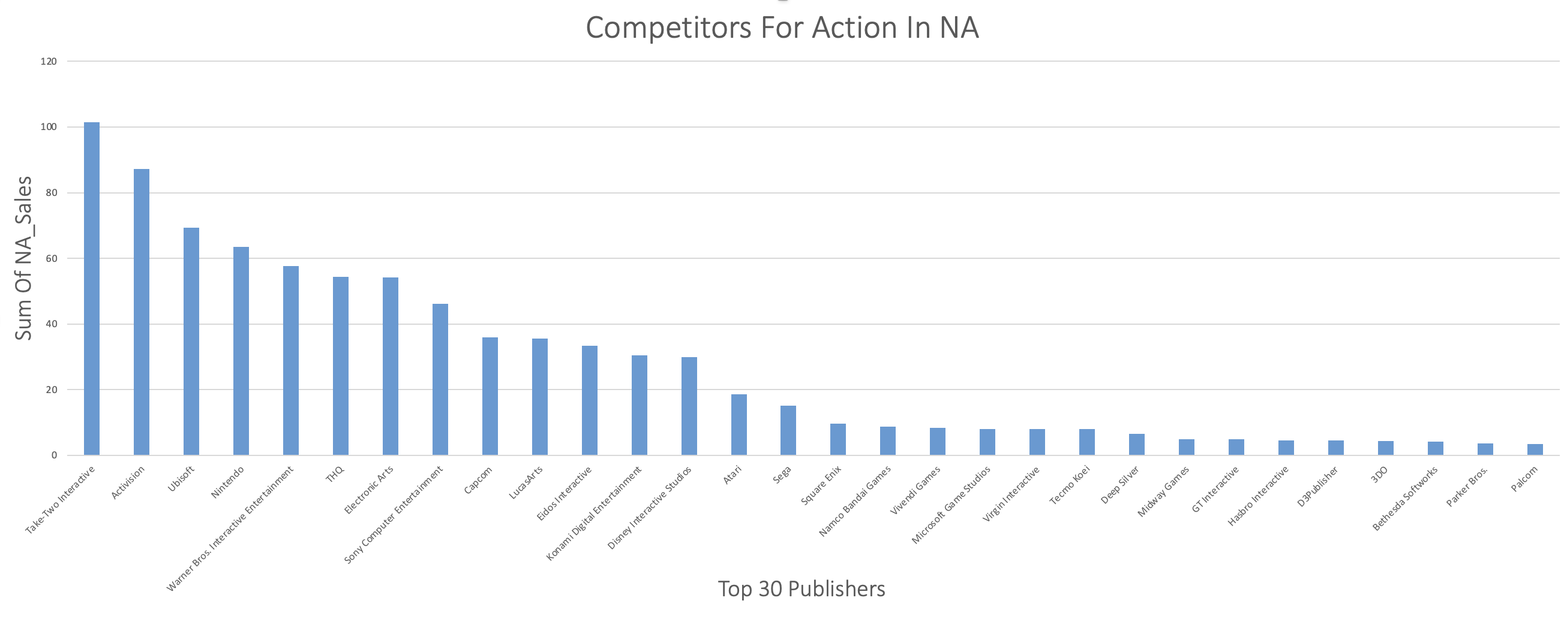

Slide 16
Recommendations Summary

Slide 17
Regions To Focus On
1. North America
2. Europe
3. Japan

Slide 18
Top Genres To Invest
Action
Adventure
Shooter
Sports
Roleplaying
Misc.
Platform
Racing

Slide 19

Competitors In North America
Sega
Konami Digital Entertainment
Warner Bros. Interactive Entertainment
Capcorn
Disney Interactive Studios
Namco Bandai Games
Lucas Arts
Bido’s Interactive
Square Enix

Slide 20

Competitors For Action In North America
Atari
Sega
Square Enix
Namco Bandai Games
Vivendi Games
Microsoft Games Studios
Virgin Interactive
Tecmo Koel
Deep Silver
Midway Games

Slide 21
Some Additional Insights (Bonus)
Steep Decline In The Gaming Industry After 2009
To Investigate Reasons - Do More Market Research
Depending on outcome- Rethink gaming strategy

Slide 22
Thank You!

